Slide 1
CRICKET DREAMER
TEAM: EPIC BYTE

Slide 2





OUR TEAM
Vedant Warke
Devang Parab
Xavier Institute of Engineering
Xavier Institute of Engineering
John Baby
Asad Shaikh
Xavier Institute of Engineering
Xavier Institute of Engineering
Vishal Mamluskar
Xavier Institute of Engineering

Slide 3
INTRODUCTION
Welcome to "Cricket Dreamer", where the exciting world of cricket meets cutting-edge Machine Learning (ML) technology. Our project comprises two indispensable components: "Dream 11 Predictor" and "Match Win Predictor".
Through meticulous data analysis and predictive modeling, Cricket Dreamer aims to empower cricket enthusiasts with data-driven insights that elevate their fantasy cricket experiences and intensify the anticipation of match outcomes. Join us on this exhilarating journey, where the fusion of cricket and machine learning takes sports analysis to new heights.

Slide 4

OBJECTIVE STATEMENT
Our mission is to revolutionize fantasy sports, leveraging advanced AI algorithms to predict optimal Dream 11 team formations and match outcomes.
We are dedicated to empowering Dream 11 enthusiasts with accurate and data-driven predictions, enhancing their decision-making prowess. Through insightful analytics and engaging experiences, we strive to redefine how sports fans interact with their favorite games.

Slide 5
Project Summary
"Cricket Dreamer" is an innovative ML data analysis project that revolutionizes cricket engagement. With its two dynamic features, "Dream 11 Predictor" and "Match Win Predictor".
The platform empowers users to create the ultimate fantasy cricket team that is the best combined 11 of playing teams in the Dream 11 Prediction module and anticipate match outcomes accurately in Match Win Predictor module.
By leveraging historical data and advanced algorithms, Cricket Dreamer enhances the thrill of cricket, fusing data-driven insights with passionate sports fandom.

Slide 6
Datasets Used
Kaggle Link: https://www.kaggle.com/datasets/vora1011/ipl-2008-to-2021-all-match-dataset
About this Dataset:
This link contains the 2 datasets:
Dataset which contains the record of every ball in IPL.
Dataset which contains record of every match in IPL.

Slide 7
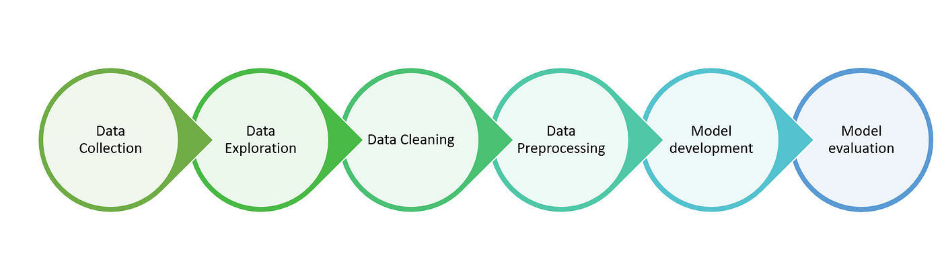
Flowcharts

Slide 8
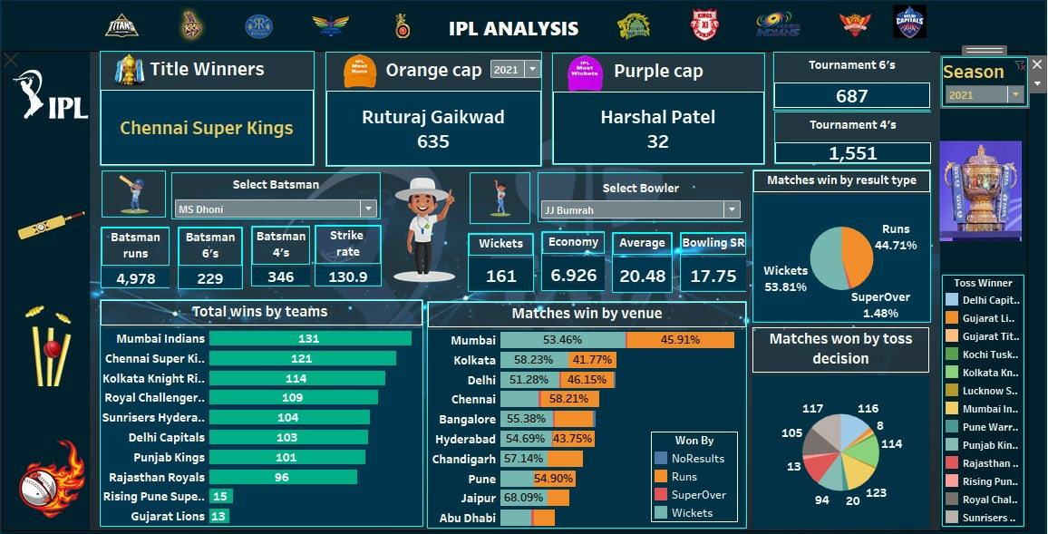
Data Visualization of Charts and Graphs

Slide 9
Conclusion
"Cricket Dreamer" emerges as a game-changer in the world of cricket analysis, seamlessly blending the art of sports fandom with the precision of machine learning. By providing users with the invaluable tools of "Dream 11 Predictor" and "Match Win Predictor" this project empowers cricket enthusiasts to make informed decisions and deepen their connection to the sport they love.
As we continue to evolve and refine our data-driven approach, Cricket Dreamer aims to reshape the way cricket is experienced, making it an exhilarating journey of anticipation and excitement for fans worldwide. With Cricket Dreamer, the future of cricket data analysis is brighter than ever before.

Slide 10
THANK
YOU

